Slide 1
Story Creation

Slide 2
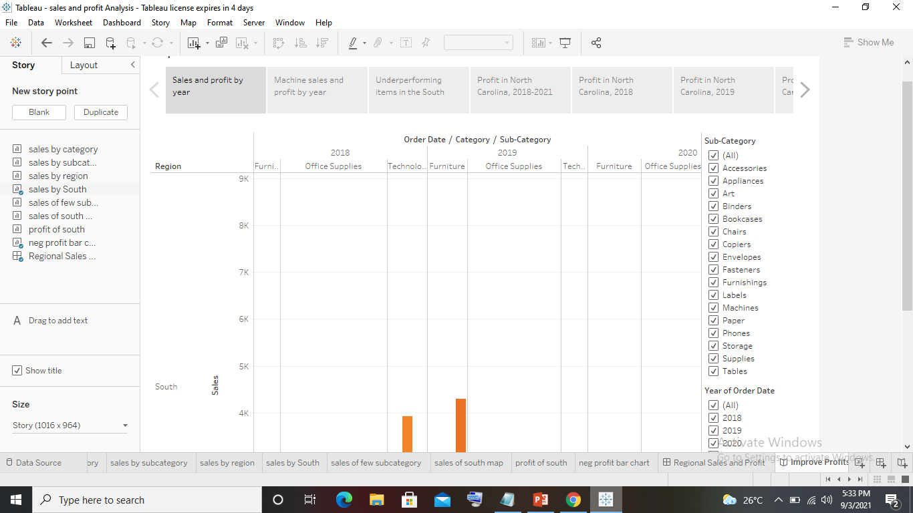
Create a story to present all your insights to your team.

Slide 3
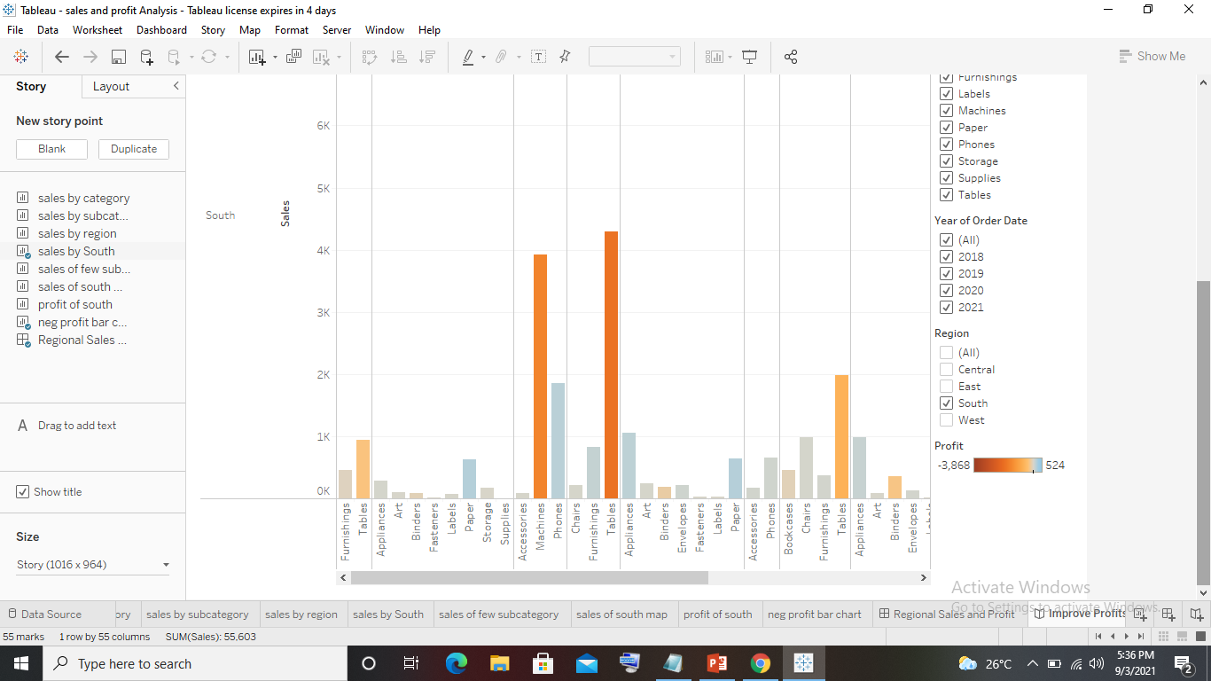
Show the sales in the south worksheet in your story.

Slide 4
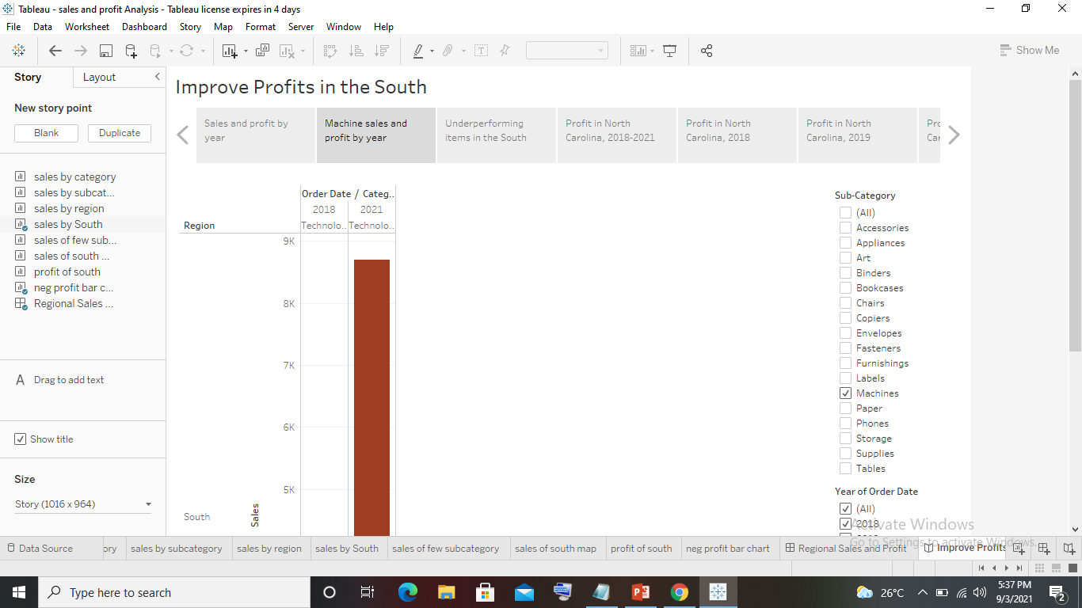
4. Duplicate the first caption and show the story for Sales & profit for machine type subcategory.

Slide 5
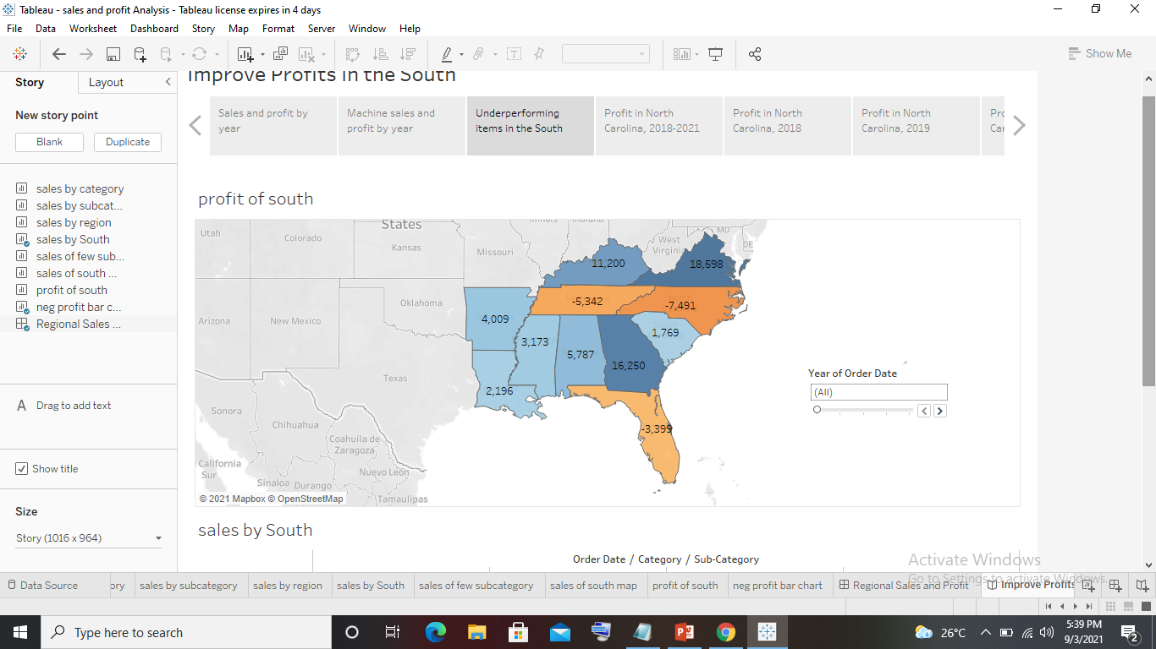
select Blank in the Story pane then, drag your dashboard Regional Sales and Profit onto the canvas and find some meaningful insights.

Slide 6
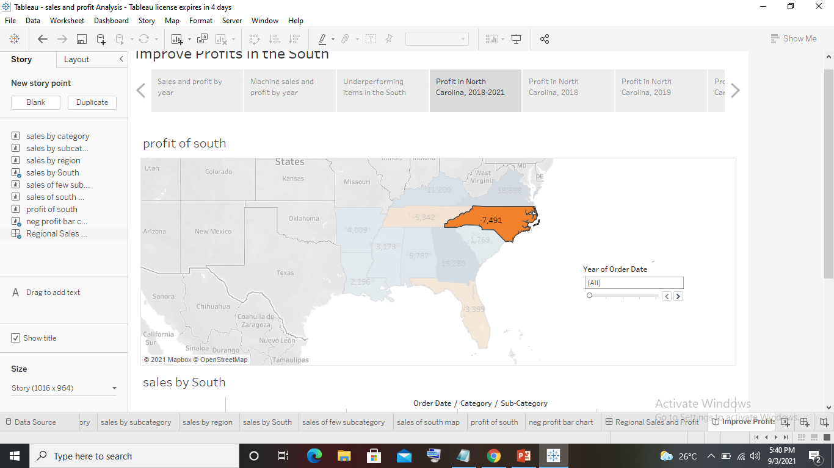
Duplicate the above story point and show your result only for north Carolina and all the year.

Slide 7
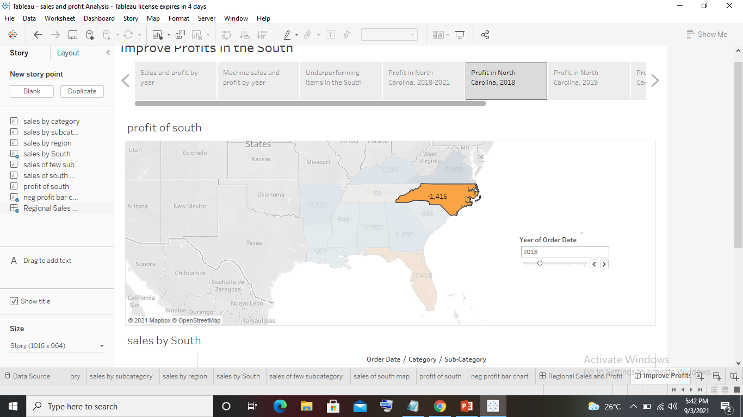
Duplicate the above story point and Show the profit in the North Carolina for 2018 and add a caption ‘Profit in North Carolina, 2018’.

Slide 8
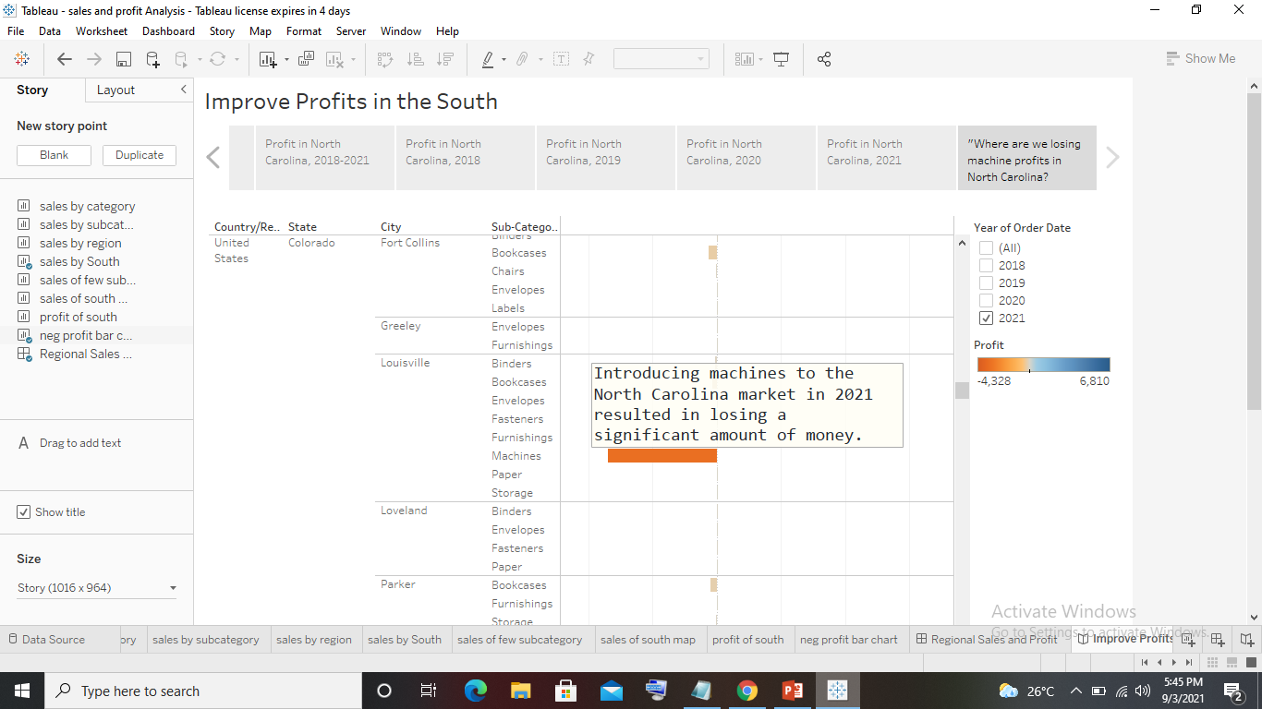
click Blank and drag Negative Profit Bar Chart to the view.

Slide 9
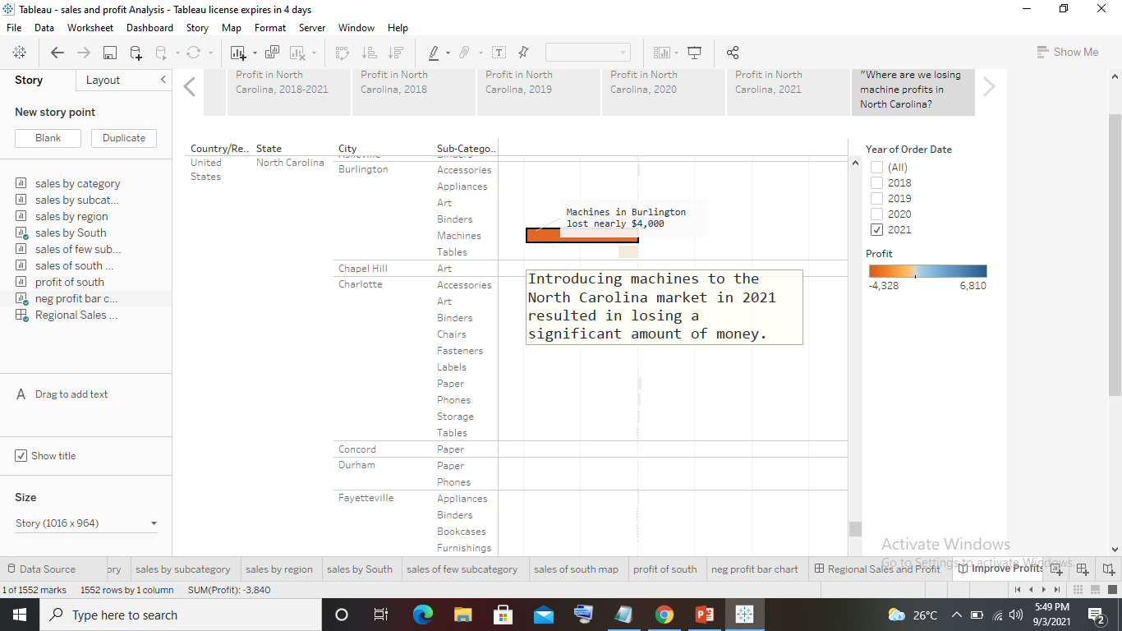
click the Burlington mark (the bar) and select Annotate >

Slide 10
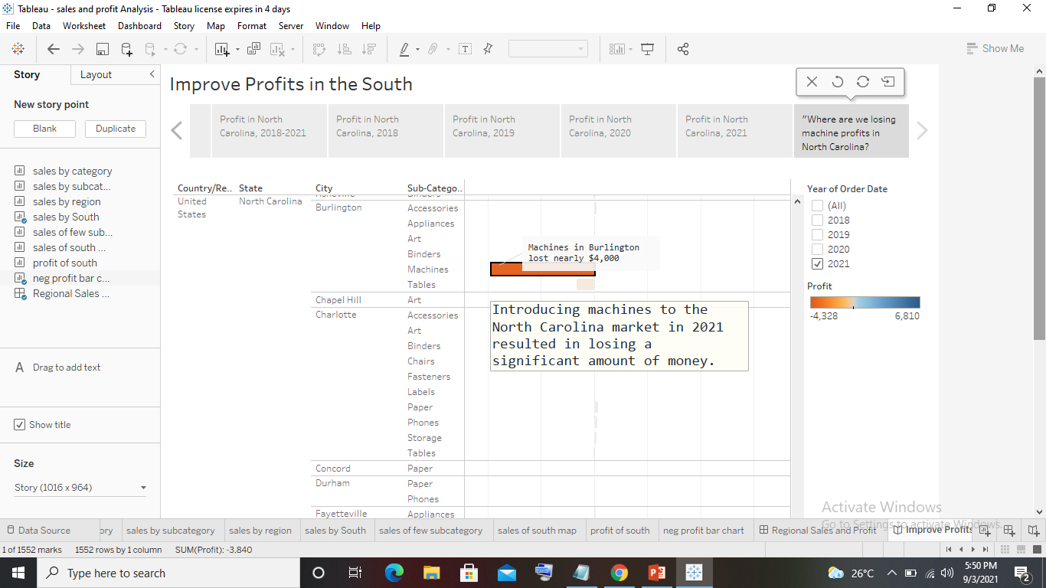
Rename your story as "Improve Profits in the South“ and check in the presentation mode.

